Slide 1
The Patmos Initiative
The Bible in Seven Global Contexts

Slide 2



Slide 3
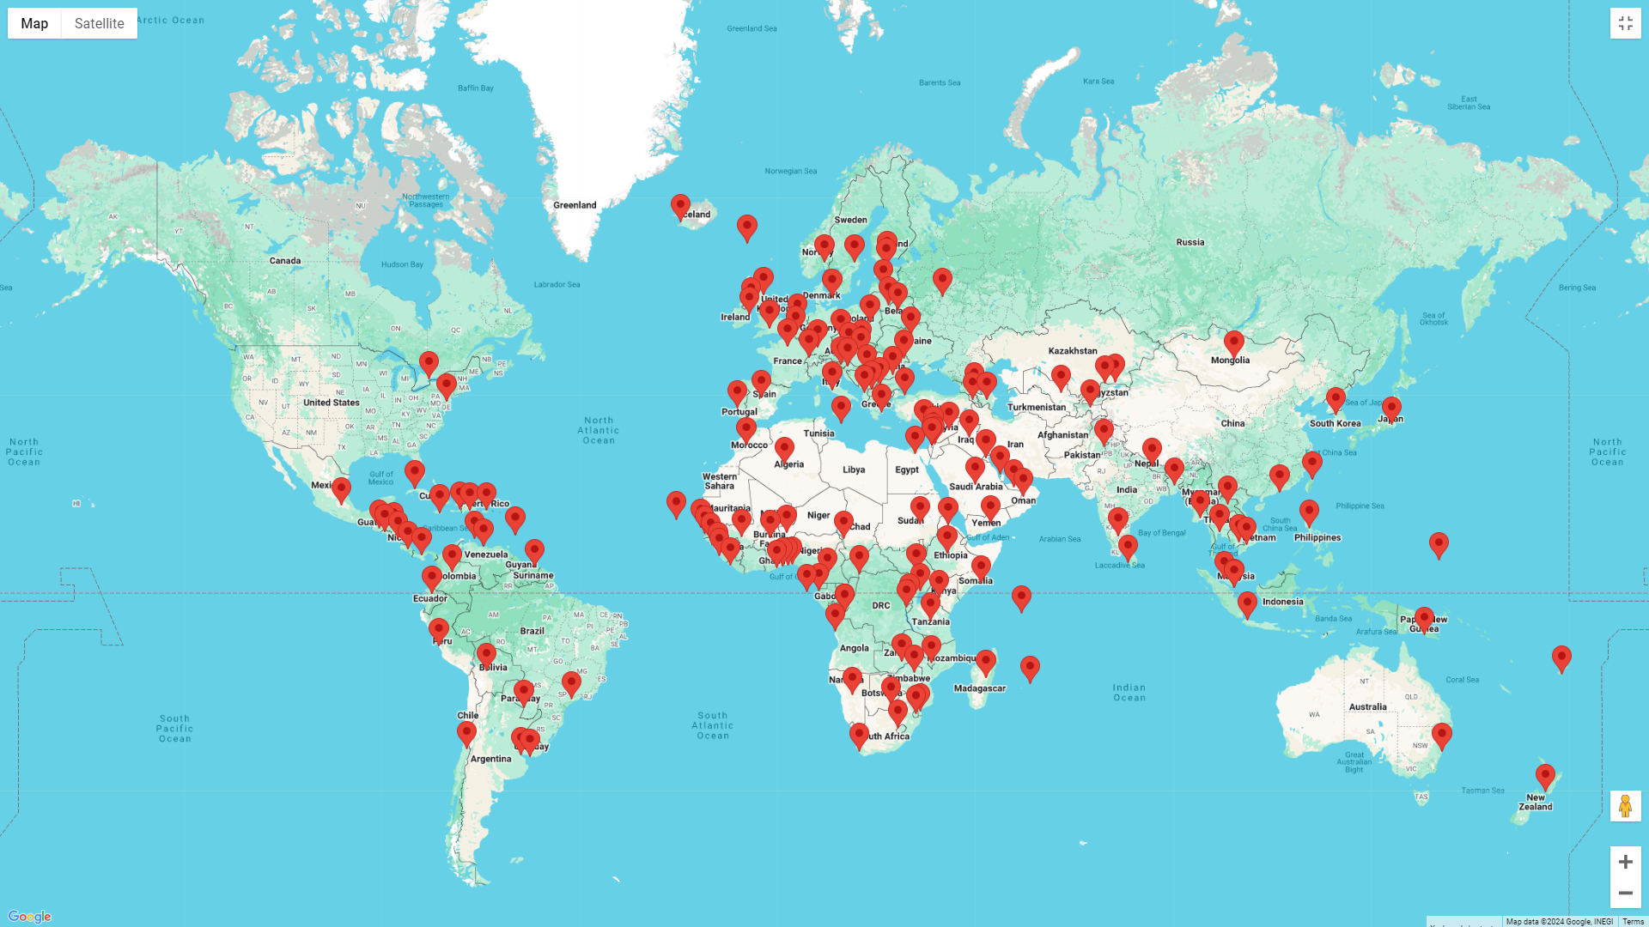

Slide 4
Reimagining Global Bible Mission
We are reaching a stage in the history of humanity where for the first time Bible availability will have been achieved for most of the world’s population.
By 2033, the Bible (in whole or in part) will be available to 99% of the world’s population in a language they can understand.
But what impact does this have on people's lives?
The next frontier for Bible mission is Bible Engagement – the process through which the message of the Bible moves from a written text to making an impact on people's lives and their communities.

Slide 5
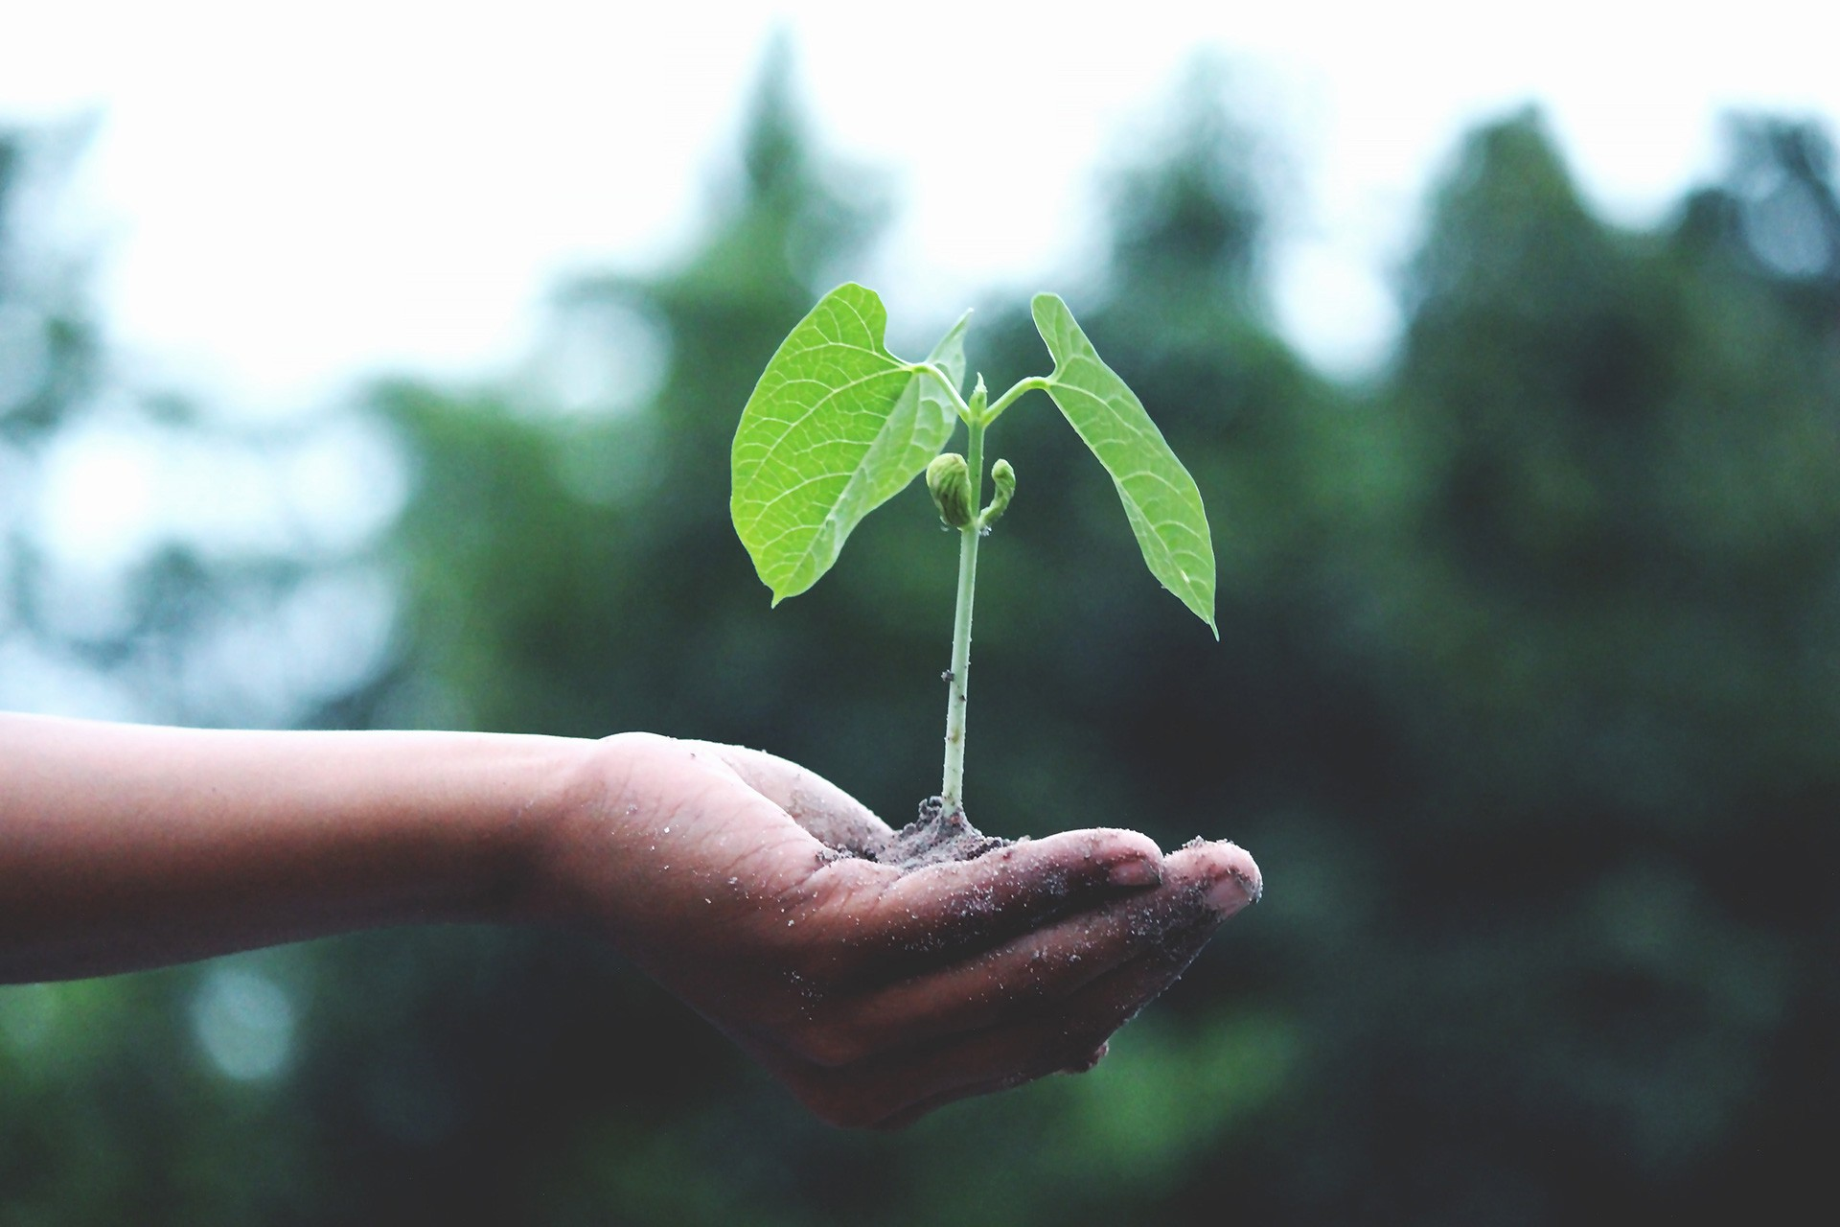
The climate affects what can grow but also how things grow

Slide 6
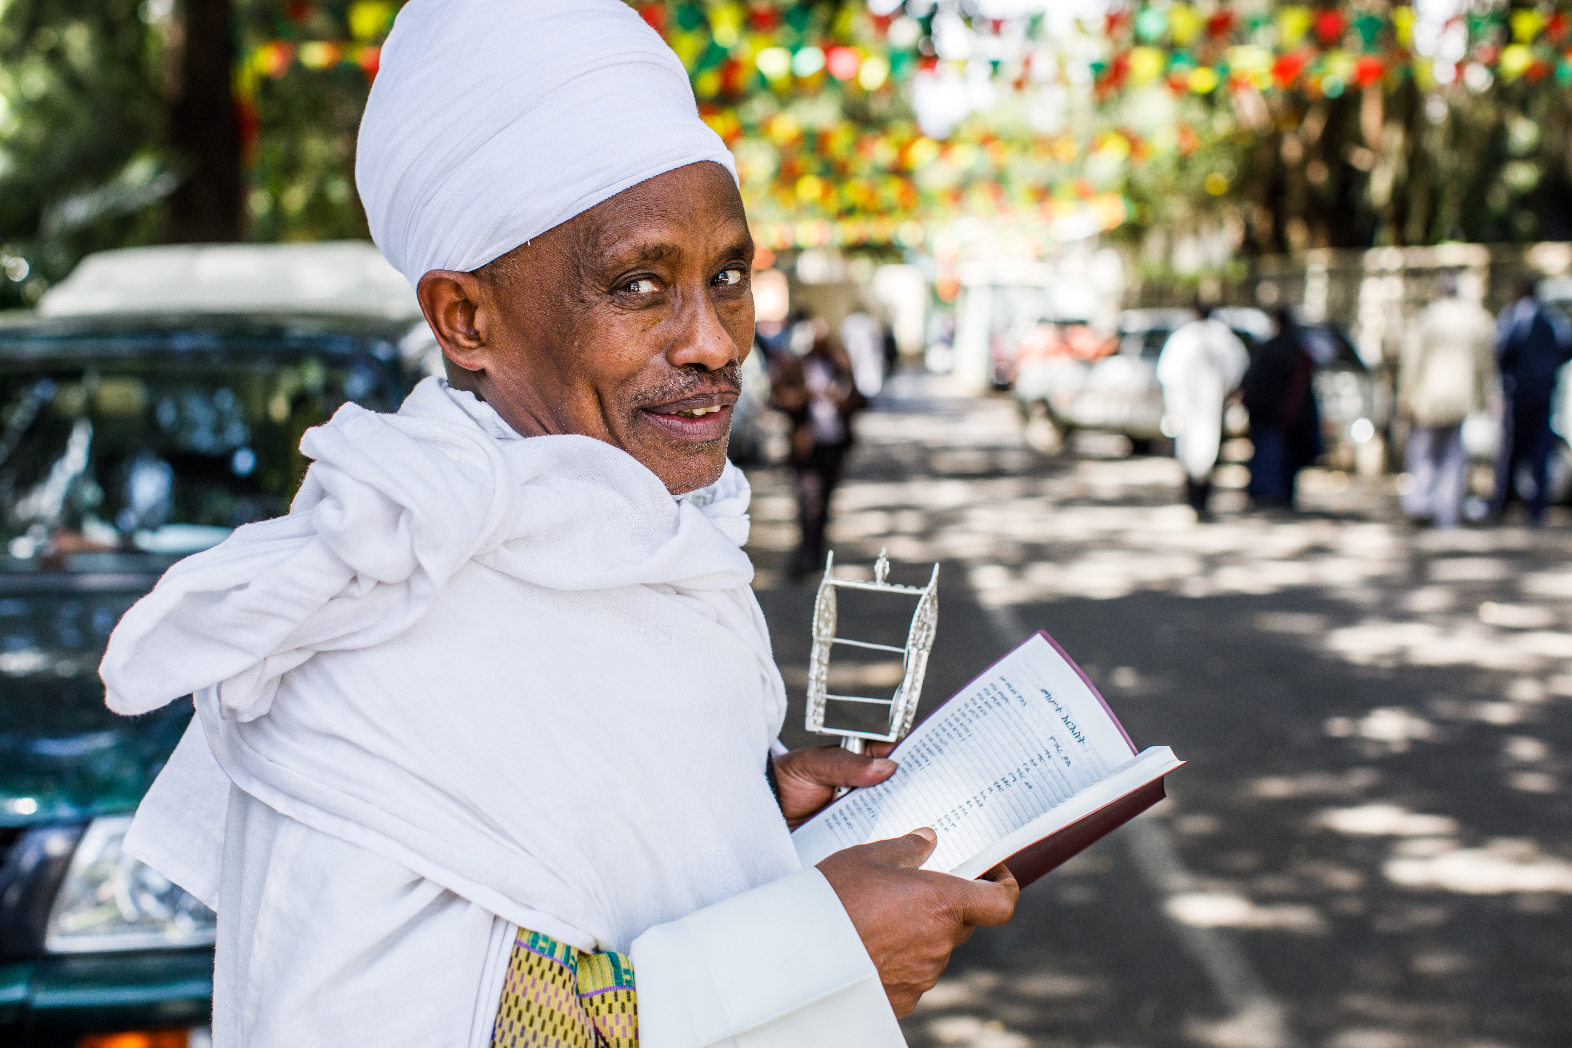
The better we can understand different global contexts, the better equipped we will be to ensure the Bible is presented to all people in ways that help them engage with it.

Slide 7
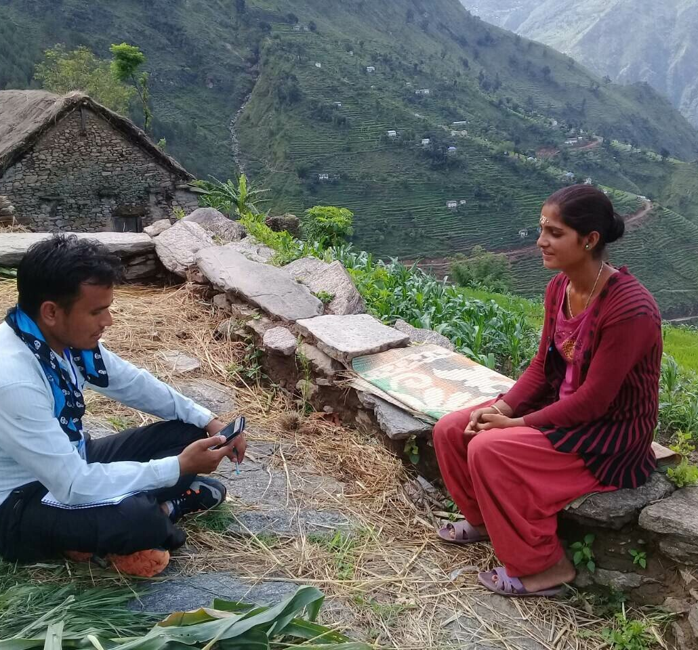
The Patmos World Bible Attitudes Survey
In 2023 Gallup collected data across 85 countries from approx. 91,000 people.
Questions were asked about:
Attitude to religion
Use of the Bible*
Attitude to the Bible*
Knowledge of the Bible*
Image credit: Gallup
*Due to government restrictions, in 18 countries we could only ask Christians about the Bible and in 5 countries we could not mention the Bible at all.

Slide 8
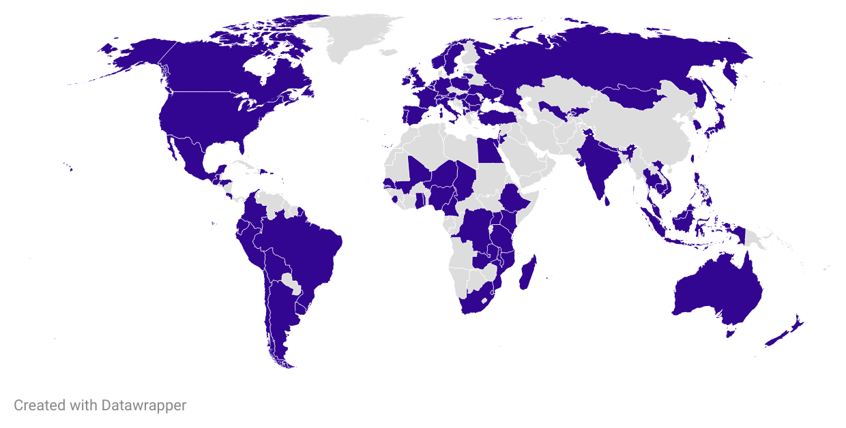
In 2023 Gallup conducted in-person, telephone and internet-based surveys. Across the 85 fieldwork countries, each had a minimum 1,000 sample size.

Slide 9
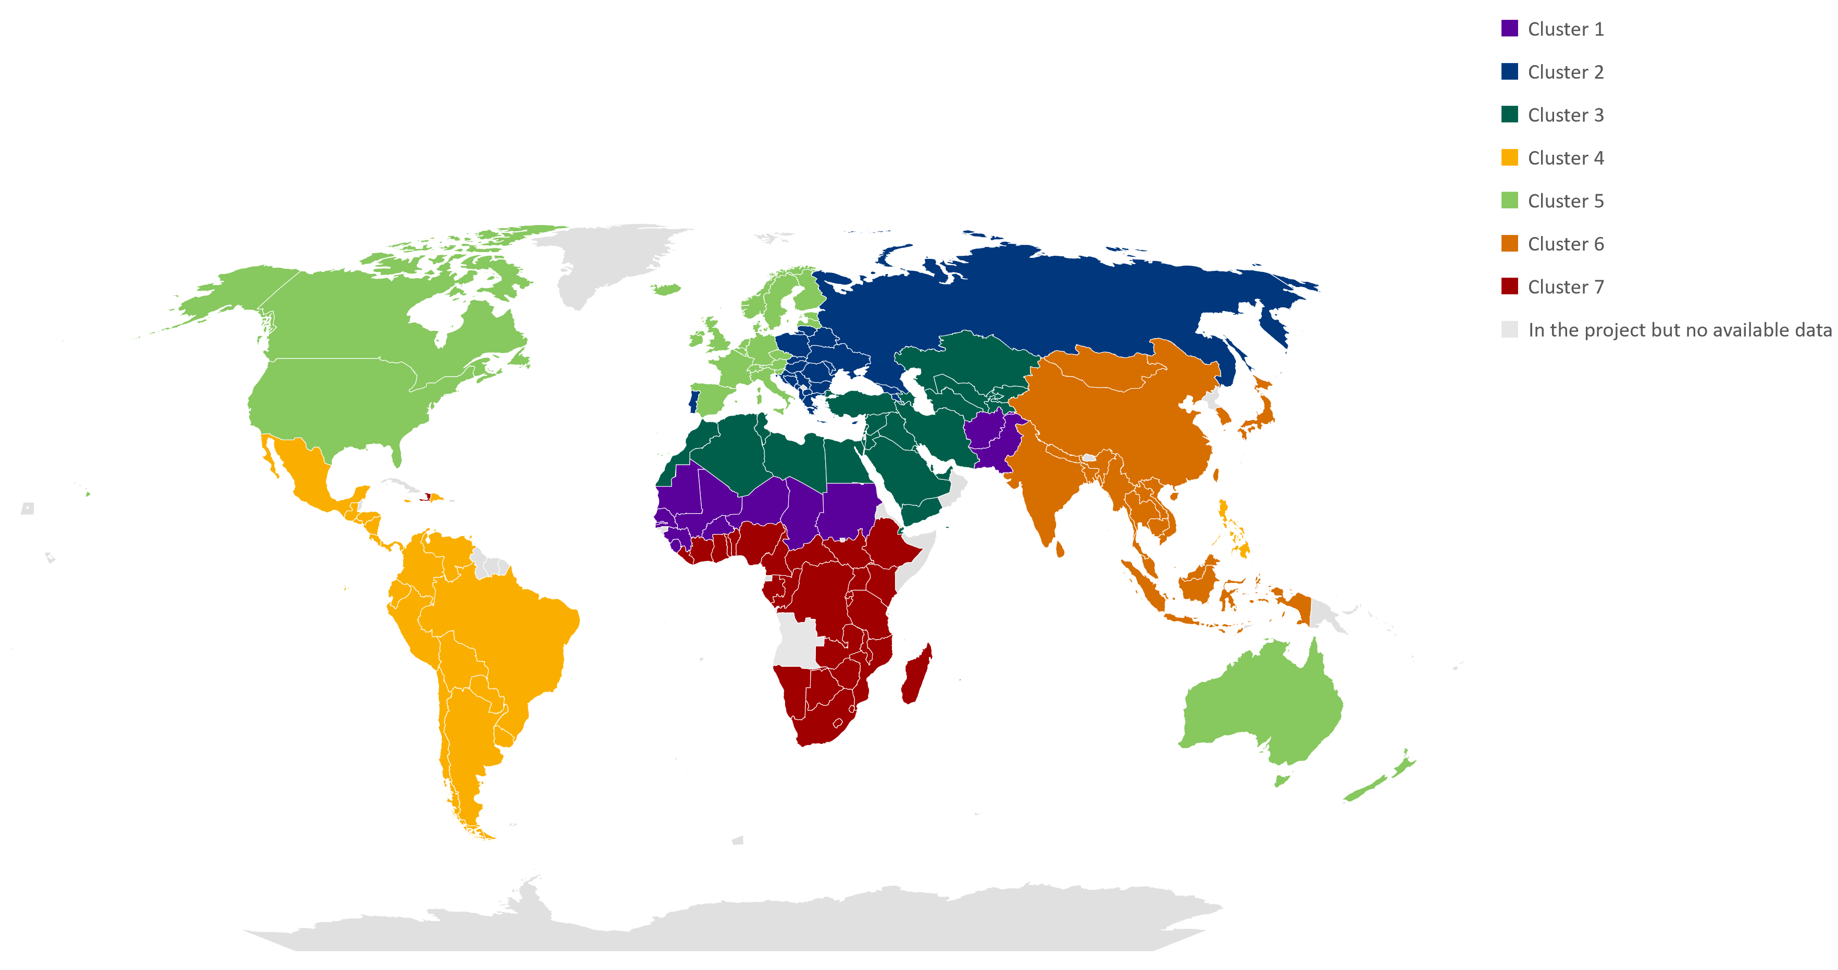
Global typology Identifying 7 mission contexts around the world

Slide 10



What are some of the key missional characteristics of this group of countries?
Religion is important to people, and they are warm towards the Bible.
Most identify with a Christian tradition (71%) and nearly everyone says religion is an important part of daily life. There is a strong sense of positivity towards the Bible, with more than three in four interested in learning more about it.
91% say religion is an important part of their daily life
76% are interested in learning more about the Bible
85% believe it is good for children to know some stories from the Bible
Top three words people chose to describe the Bible: truth, wisdom and comforting

Slide 11



What are some of the key missional characteristics of this group of countries?
Economic inequality and perceptions of Christianity’s connection to the West present challenges for Bible engagement
There are high levels of social inequality across this group of countries:
The richest 20% own half of the wealth (52%)
Yet, 47% are living in poverty, the highest percentage across the seven mission contexts
The population is young, one in five are aged 15-24. Amongst this group and the wider population there are questions about the relationship between Christianity and the West:
47% believe Christianity is essentially a Western religion
43% use traditional healers when they or someone they know is sick

Slide 12
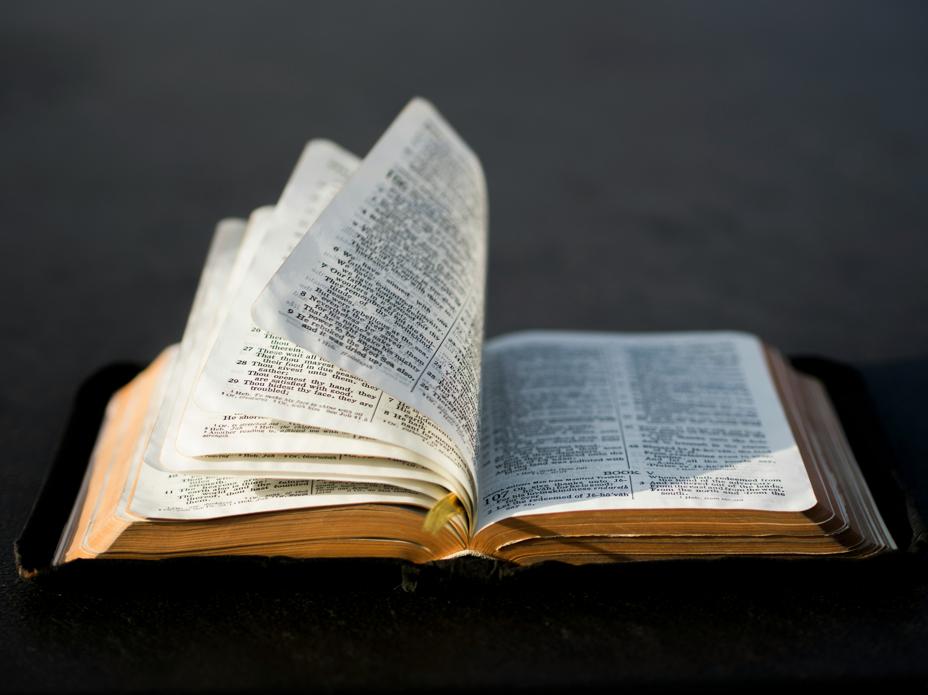
People and the Bible
Are they reading it and what do they think about it?

Slide 13
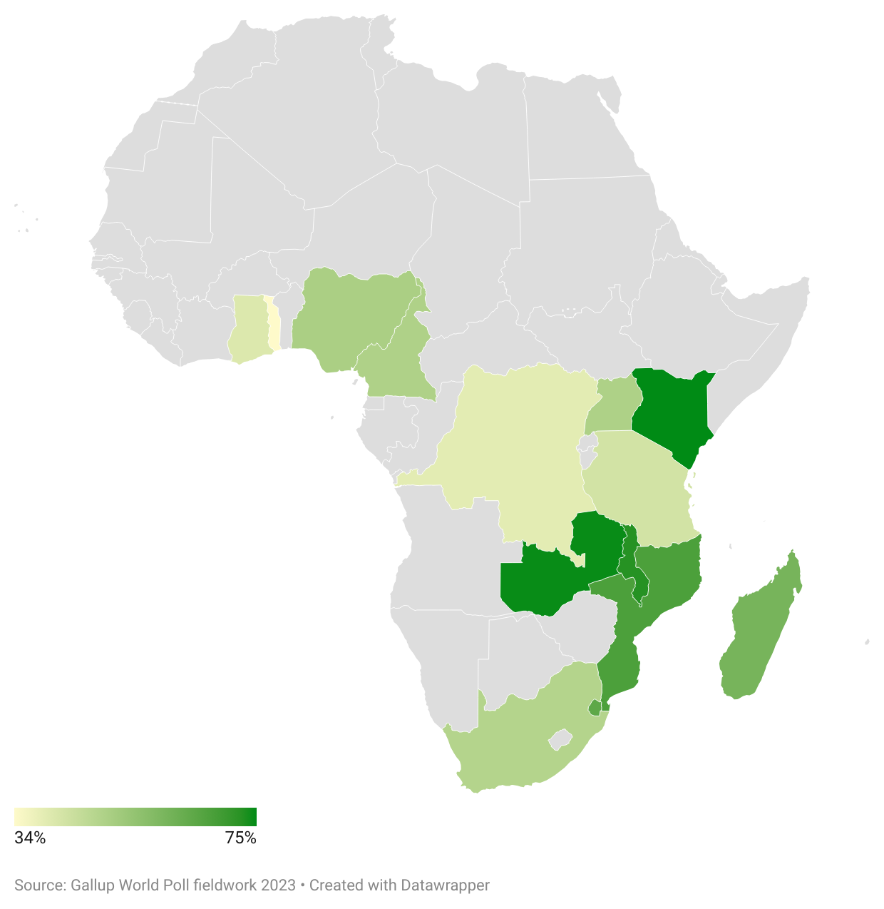
51% of people report using the Bible on a weekly basis. Kenya and Zambia have the highest weekly Bible use at 75%. Togo (34%) and the Democratic Republic of Congo (39%) have the lowest.

Slide 14
Christians report strong confidence in engaging with the Bible
We asked Christians about their confidence in describing the Bible's story, finding relevant passages, discussing its message, and guiding others in interpretation.
Christians in these countries generally show higher Bible confidence than global averages. Over 80% in Kenya, Madagascar, and Nigeria are confident in all areas, compared to just over 50% in Eswatini, Togo, and Uganda.

Slide 15
Bible’s influence on decisions and challenges: a mixed impact
We asked Christians about the Bible's influence on their decisions, responses to challenges, and reactions to bribes.
While the Bible highly influences decisions and challenges, its impact on responses to bribes is significantly lower.
In Malawi and Kenya, 42% and 38% respectively disagree that the Bible influences their response to bribes.

Slide 16
Exploring Bible use and Gallup’s Life Evaluation Index
The Life Evaluation Index categorizes people as ‘Thriving’, ‘Struggling’, or ‘Suffering’ based on their current and future life ratings.
We compared life evaluations among regular, infrequent, and non-Bible users.
Our data showed little variation, with most in the ‘Struggling’ category. Monthly Bible users are slightly more likely to be Thriving and less likely to be Suffering.

Slide 17
Regular Bible users show greater acts of kindness
We asked if people had volunteered their time, helped a stranger, or voiced their opinion to a public official in the past month.
Regular Bible users were more likely to do all three compared to infrequent and non-Bible users.

Slide 18
What could all this mean for Bible engagement in sub-Saharan Africa?
The data reveals two compelling narratives. The first is a story of hope: people cherish the Bible, seeing it as a source of truth and wisdom. They engage with it regularly, feel confident in their understanding, and let it guide their daily lives. This is good news!
However, the second story presents a challenge. Despite this deep connection with the Bible, social inequality remains high, and many still rate their lives as 'struggling.' The transformative power of the Bible's teachings isn't fully reflected in societal change.
The question we face is how to bridge this gap. How can we harness this profound love for the Bible to foster deeper engagement and drive greater personal and societal transformation?
Together, can we find ways to turn this love into lasting impact.

Slide 19
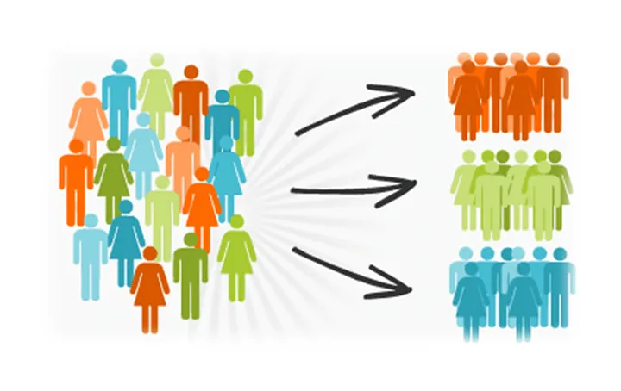
64 audience groups across seven distinct mission contexts
Understanding our audiences is key to deeper Bible engagement.
The Patmos Survey identifies 64 audience groups across seven mission contexts, based on their relationship with the Bible.
This includes 8 audience groups in sub-Saharan Africa. Join our online launch event to learn more.

Slide 20
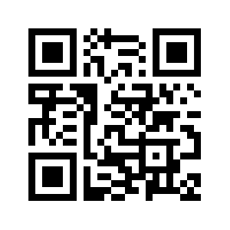
Join us on 30 April 2025 for the online launch of The Patmos Survey
Visit patmos.bfbs.org to register or scan the QR code

